Slide 1
A
1234 = 0
5420 = 1
6612 = 2
6280 = 4
1750 = ?
Notes:
Number of circles

Slide 2
B
2564 = ?
4887 = 6
7312 = 1
8059 = 4
6825 = 1
Notes:
* , %

Slide 3
C
1156
600
1842
600
7
0
1496
8
?
100
472
228
Notes:
-,/2,3v

Slide 4
D
104
6
101
2
12
6
8
?
8
2
5
3
Notes:
-,x

Slide 5
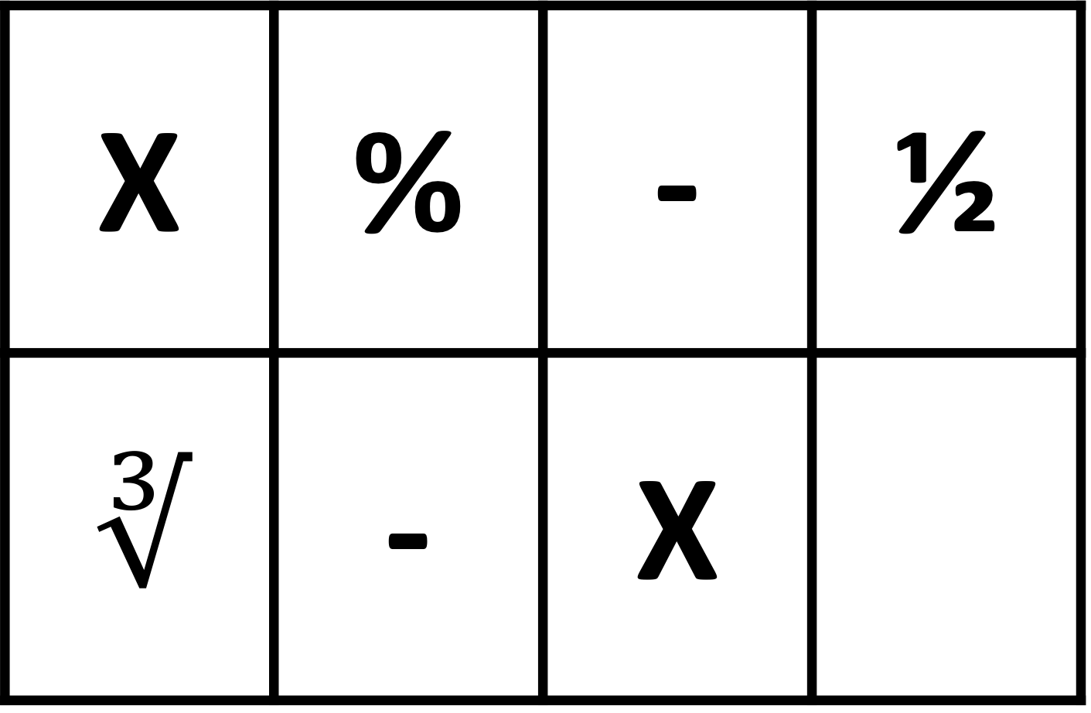
X | % | - | ½
$$∛$$ | - | X

Slide 6
A
B
C
D

